Slide 1
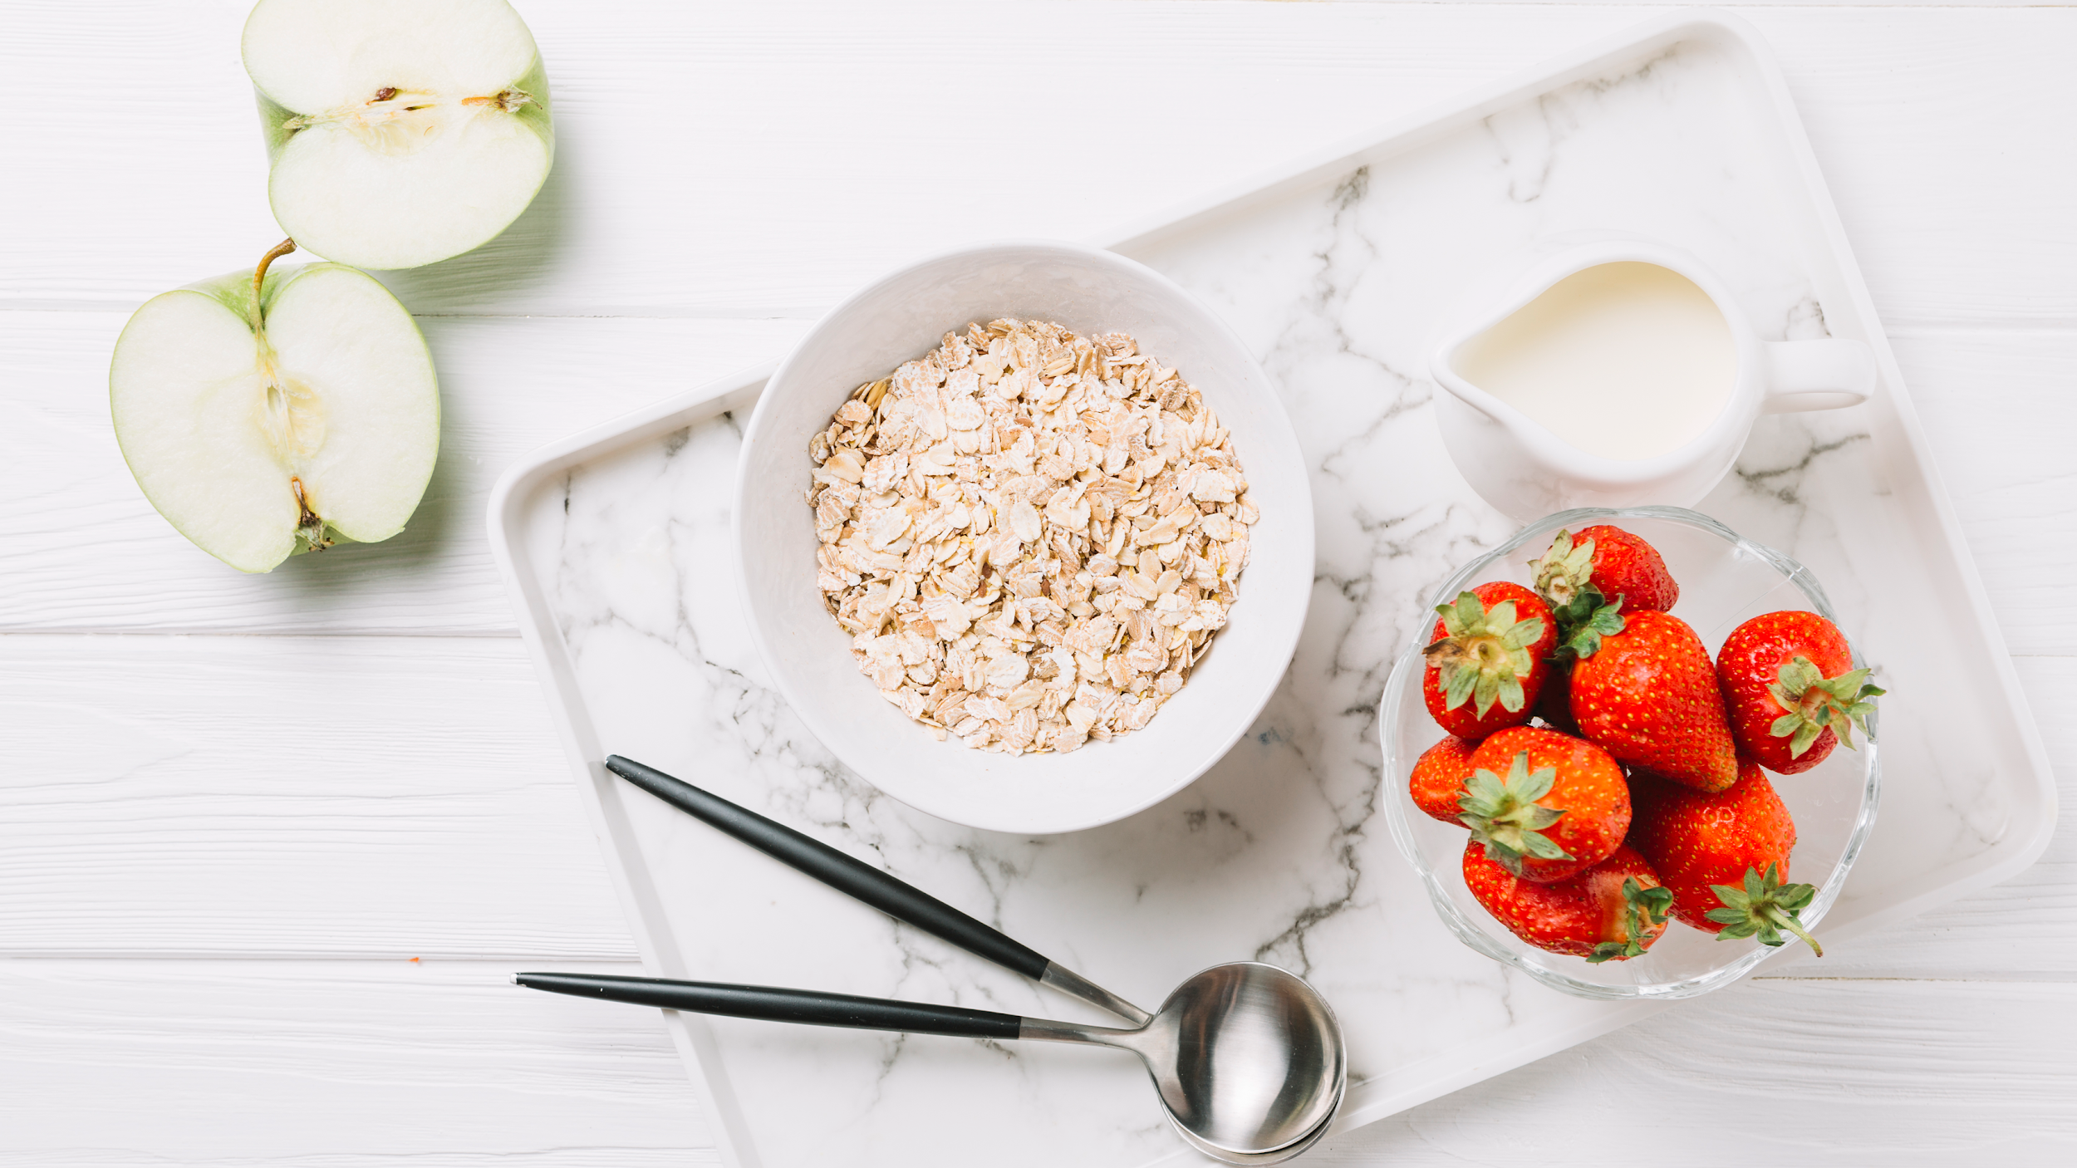
Nutritionist App

Slide 2
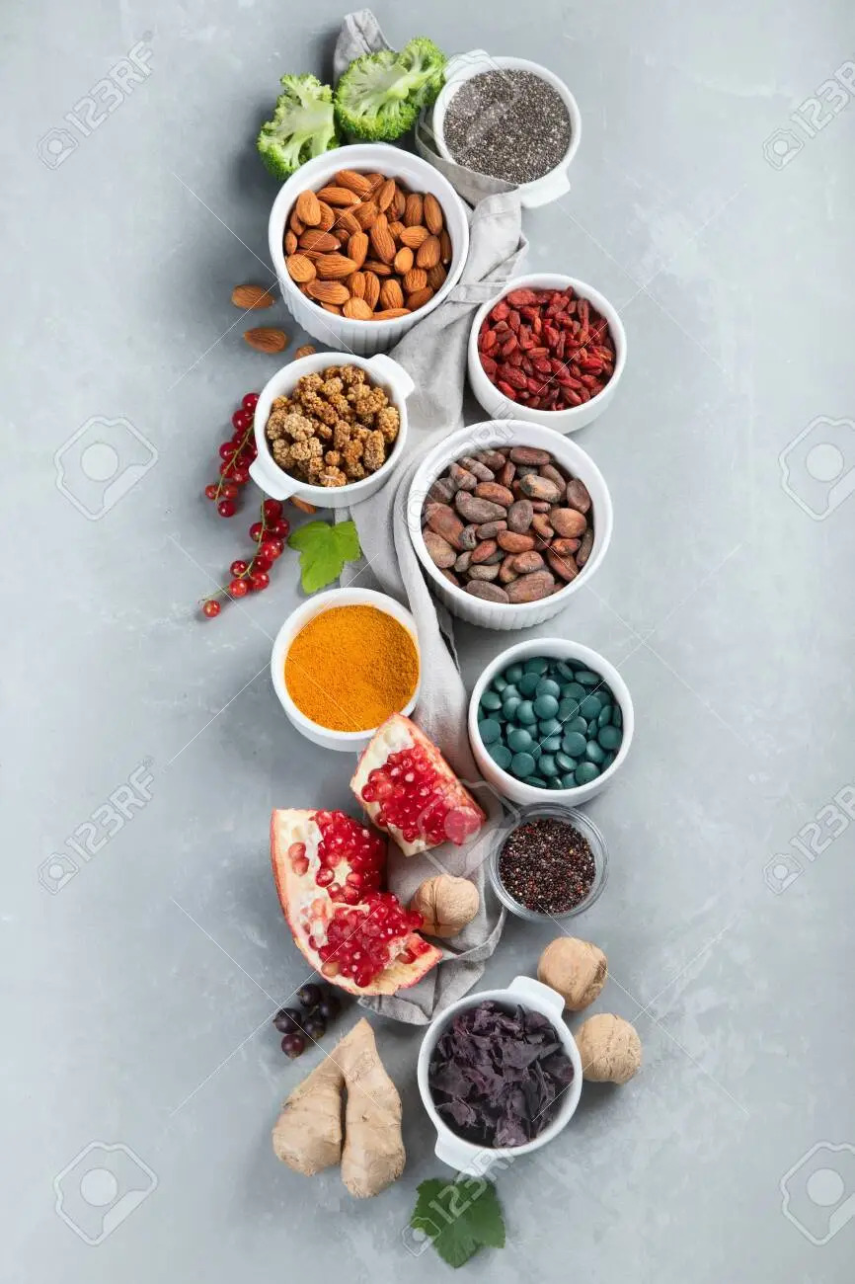
Introduction
Objective
Features
Angular
Microservice
Architecture
Project Overview
Application Flow
Technology and Tools Used
Conclusion
Outline

Slide 3
To design an enhanced Nutritious Food information system and experience for customers such that they get better experience.
Problem Statement

Slide 4
Introduction
Nutritionist App is a platform where you
can keep information of different Nutritious Food.
Users can register themselves in the
application and save search data as a logged
user and have functionality to put foods in
Favourite.

Slide 5

Objective
Our objective is to provide the in depth information of each food nutrition to the user online without stepping outside.

Slide 6

Application Features
Register User
Login User
Search Food Items
Mark Favourite Food Items

Slide 7
Angular
Angular is a platform and framework for building single-page client applications using HTML CSS and TypeScript. Angular is written in TypeScript.
Advantages of using Angular :
Effective Cross-Platform Development.
Improved Speed and Performance.
Faster Development Process.
More Lightweight Web Applications.
Efficient Problem-Solving Patterns.
Excellent Material Design Library.

Slide 8
Angular Essentials
Components used in Project
Home Component
List Favourite-Item Component
List Food-Item Component
Login Component
Sign up Component
Navbar Component
Services used in Project
Favourite Service
Food Items Service
Login Service
Sign up Service
Auth Interceptor
Guards used in Project
Auth Guard: CanActivate

Slide 9
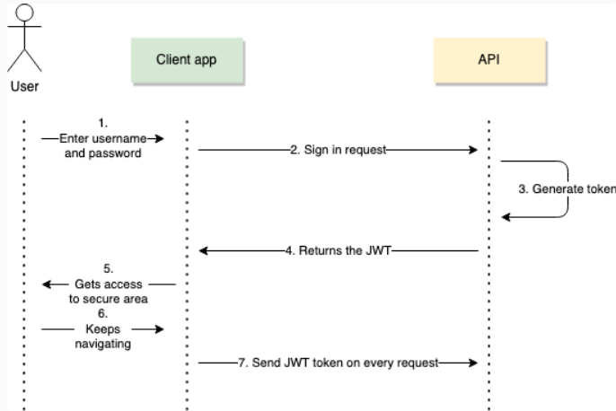
JWT
JSON Web Token is a type of authentication that deals with an encrypted JSON which we’ll call “token”.

Slide 10
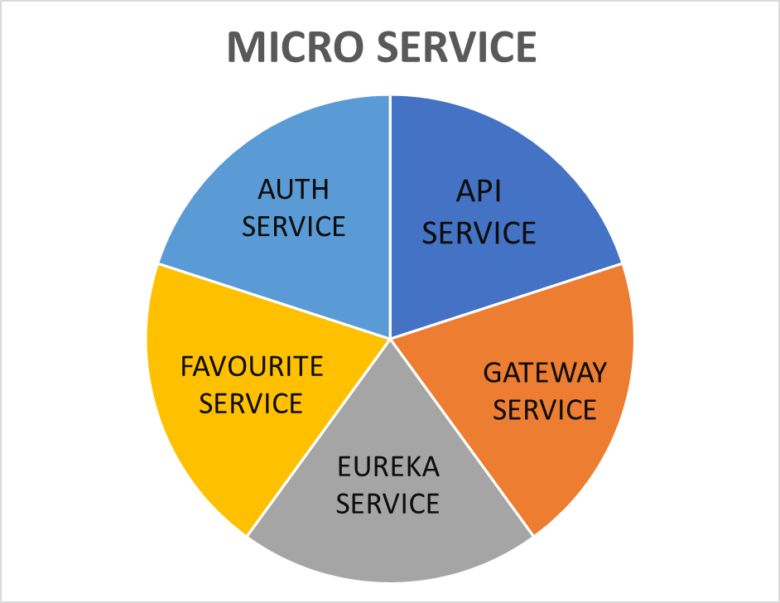
Micro Service
Micro Services Used in Project :
AUTH-SERVICE
API-SERVICE
GATEWAY-SERVICE
EUREKA-SERVICE
FAVOURITE-SERVICE

Slide 11

Project Architecture

Slide 12
Architecture
SERVICE DISCOVERY
MySQL
SERVER
AUTH SERVICE
SPA
Mongodb
API GATEWAY
FAVOURITE SERVICE
External API
API SERVICE

Slide 13

Project Overview

Slide 14
Project Overview
Favourite
Login
Auth
Service
Favourite
Service
Search
Home
Register
Api Service
MySQL Server
Mongo DB
External Api

Slide 15
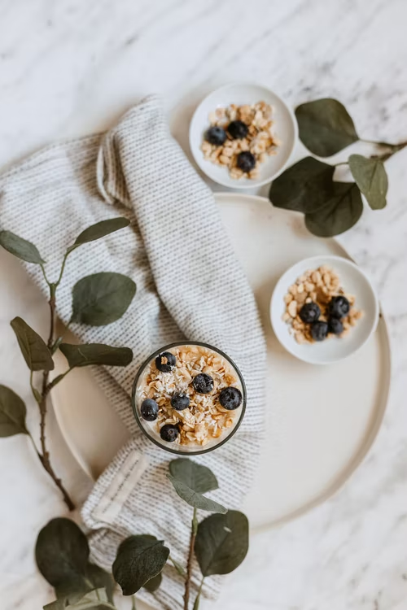
Project Flow

Slide 16

Project Flow
Home
Login
Register
Search
Add to Favourites
Favourites
Logout
Delete Favourite Food

Slide 17








Technologies and Tool Used

Slide 18
The Nutritionist app helps the user to search for a specific food to find it’s nutrition details and also view the nutrition content for a selected food.
Conclusion

Slide 19

Thank You!

